Slide 1
Assignment #2:
POVs & Experience Prototypes
Team Uno: Lucy Zhu, Zheng Lian, Xiaohai Liu, Cathy Wang

Slide 2
Introduction

Slide 3
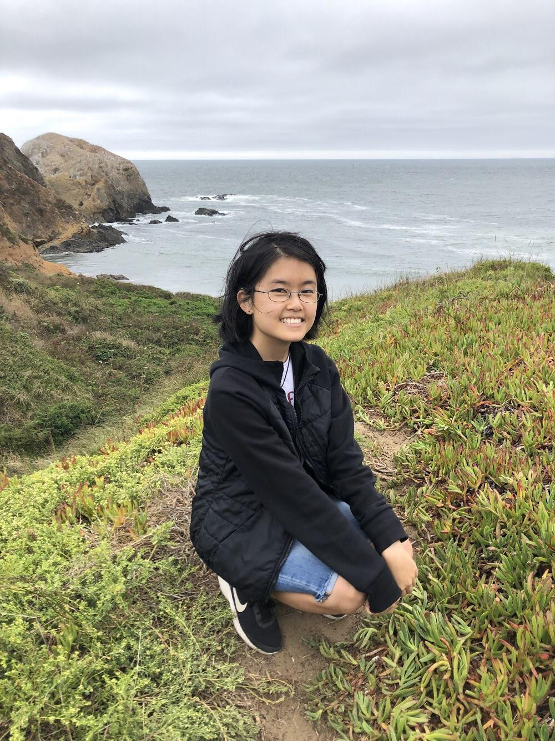
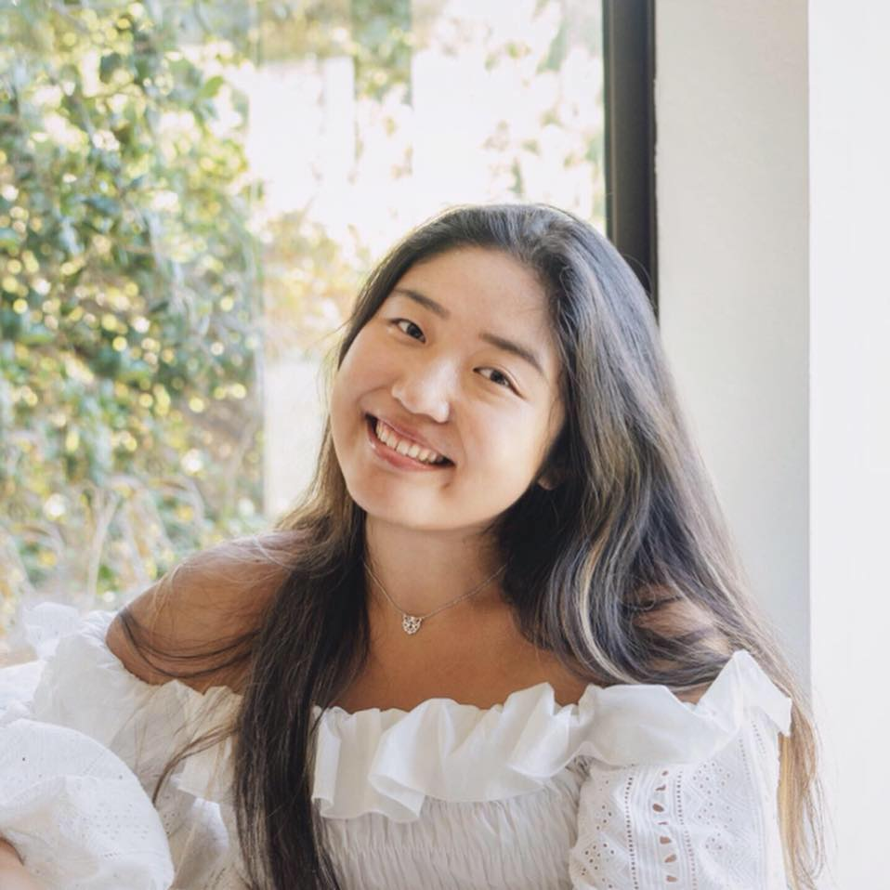
🌟Zheng
🌟Xiaohai
🌟Lucy
🌟Cathy
Team Uno
Notes:
Our team consists of 4 people: Zheng, Xiaohai, Lucy and Cathy!

Slide 4
Education
for social mobility
Notes:
Our problem domain is education for career and social mobility. We wanted to study how people transition from job to job, industry to industry. Through our first round of interviews, we realized that occupational training programs are usually inaccessible and/or unaffordable for those in need, and as a result, we also want to observe what people do in place of training programs, hoping to recognize what kind of information is needed but yet to be provided/made accessible. Our initial needfinding pointed to interpersonal connection and learning from industry experience as crucial sources of information.

Slide 5
Initial POV

Slide 6
jerry
21
Student
@Stanford University
“CS to fashion was an 180 degree turn for me”

Slide 7
We met
Jerry, a 21-year-old Stanford student formerly doing CS but has been exploring a new career path in fashion since the past gap year.

Slide 8
We were amazed that
he started a new career largely through personal interactions and learning from others’ experiences.

Slide 9
It would be game-changing
to help him establish effective and meaningful connections with industry professionals.

Slide 10
So, with that in mind...

Slide 11
Additional Needfinding

Slide 12
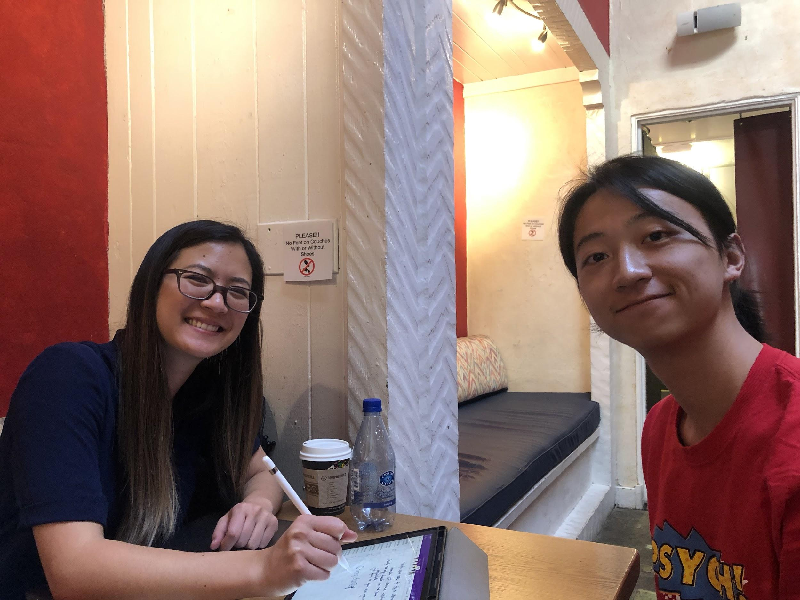
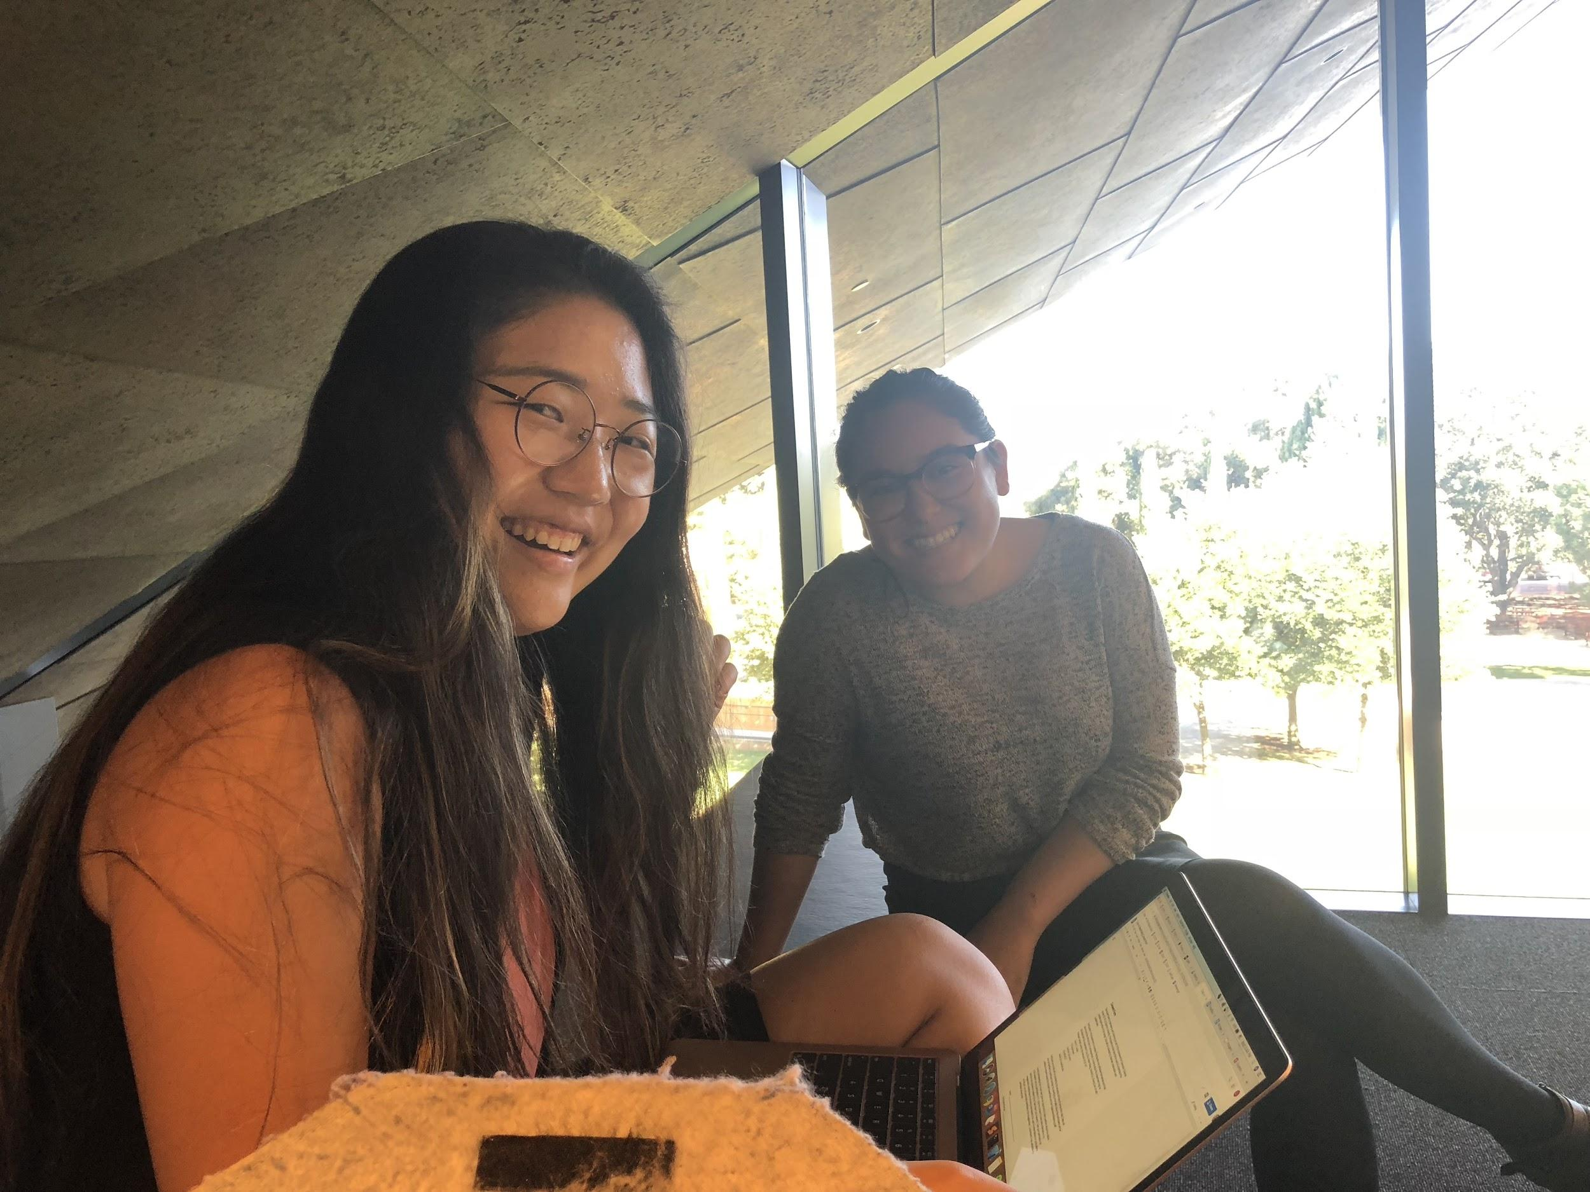
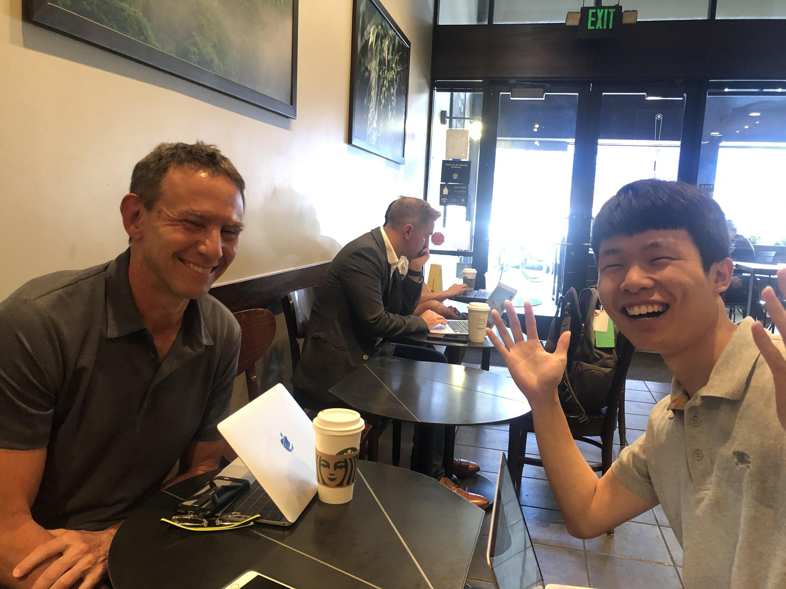
Meet our interviewees
Stacey
30s
Software Engineer
@Bay Area
Kay
29
Evening and Student Supervisor
@ Bowes Art and Architecture Library
Rob
56
CEO and Co-Founder
@MyData.Health
Notes:
So we take in the comments from last studio that we need to diversity our interviewees to include more people already with working experiences and try to understand what they want. Stacey: infomatics, Kay: East Asian Studies and Art History

Slide 13
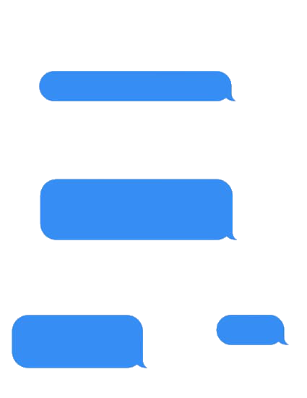
We learned...
Work experience is crucial but professional training matters for promotion
Celebrities and
key influencers
Lifelong learning!

Slide 14
Revised POVs and HMWs

Slide 15
Stacey
Revised POV
We met Stacey, a software engineer in her 30s who just returned to Bay Area and is actively looking for jobs.
We were amazed to realize that she educates herself by following the industry celebrities on media such as Twitter.
It would be game-changing if she could feel more in sync and relevant to the rapidly evolving tech industry.
HMW
Aggregate information generated by industry celebrities to facilitate the learning experience entering an industry?
Notes:
We met Stacey, a software engineer in her 30s. She studied informatics (concentrated in computer engineering) for undergraduate and joined a few software companies not long after graduation. She then worked in several startups in Australia before returning to the Bay Area, looking for positions in established tech companies. She walked us through the difficulties and challenges she had to overcome (and is still overcoming) as a female in a very competitive and male-dominated industry.

Slide 16
Kay
Revised POV
We met Kay, a 29-year-old Evening and Student Supervisor at Bowes Art and Architecture Library at Stanford.
We were amazed that although she feels ready and confident about transitioning from a gallery job to library, she is enrolled in part-time training program on library studies.
It would be game-changing if the required qualifications can be achieved more accessibly and affordably.
HMW
Ensure that her feelings of confidence reflects her abilities?
Notes:
We met Kay, a 29-year-old Evening and Student Supervisor at Bowes Art and Architecture Library at Stanford. She is confident about her occupational choices but also rely heavily on her work experience as a credential. She finds working full time while finishing a master’s degree both physically and financially exhausting, but in the meantime, she believes that keeping an open mind and learning from workspace/co-workers provide the most insight and best guidance.

Slide 17
Jerry
Revised POV
We met Jerry, a 21-year-old Stanford student formerly doing CS but has been exploring a new career path in fashion since the past gap year.
We were amazed that he started a new career largely through personal interactions and learning from others’ experiences.
It would be game-changing to help him establish effective and meaningful connections with industry professionals.
HMW
Highlight industry novice’s talents and visions to be more readily discovered and picked up by industry professionals?
Notes:
We met Rob, a 56-year-old CEO of two life science startups in the Bay Area. He has two master degrees in Public Health and Molecular Biology. Because of his digestive problems, he researched and found an effective method that grew into his own startup idea. Thus, he returned to Bay Area and have been since working on his two startups related to digestive system and medical testing.

Slide 18
Top 3 HMWs
to
PROTOTYPES!

Slide 19
Experience Prototype #1 - Tech’s IT
Notes:
We used Google Slide to simulate a news interface where the interviewee, in this case the user of the interface, would search for news based on preselected tabs of industry celebrities/major influencers. The environment will be one of learning and seeking knowledge like and catching up with the latest tech news for personal enrichment while waiting for coffee before work.

Slide 20
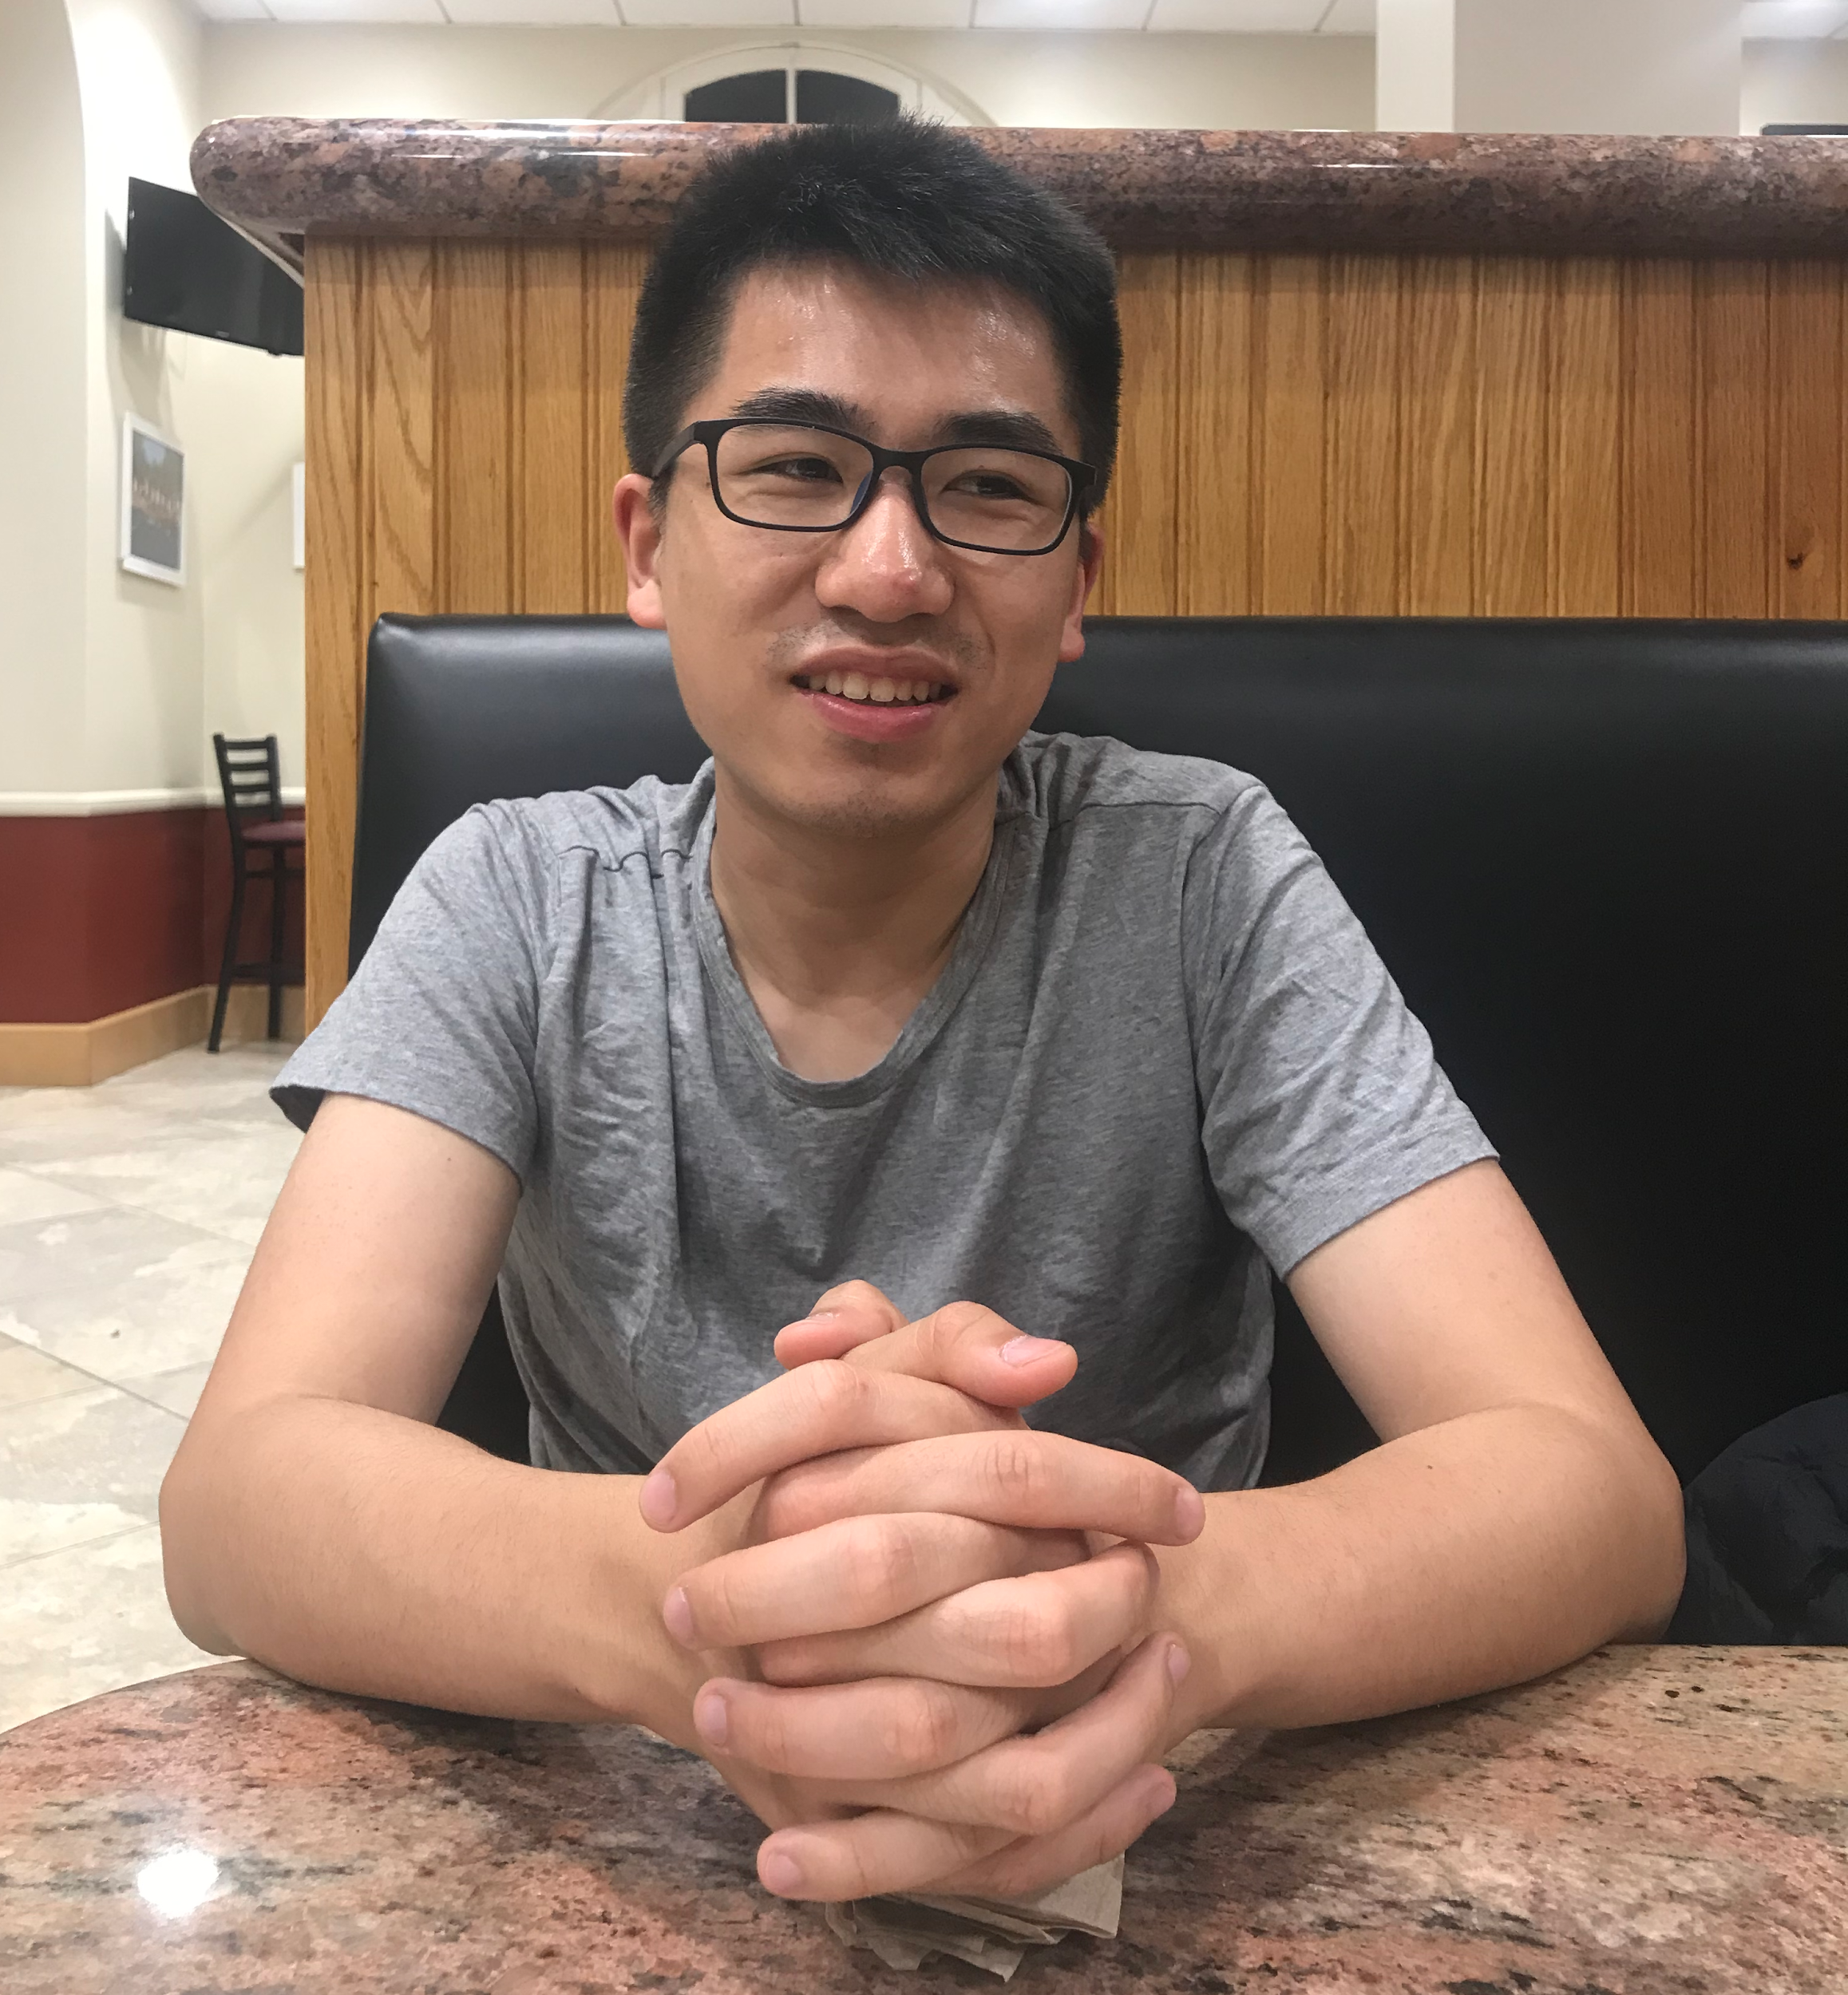
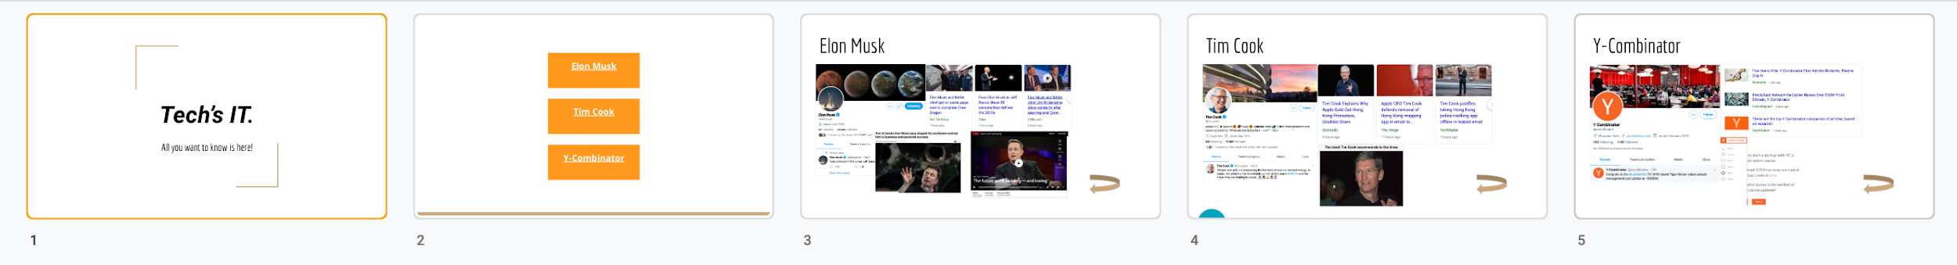
Yulou
CS Student
@Stanford
Notes:
We use sticky notes of various sizes to simulate a web interface. Imagine the background as the shirt the interviewee (who plays the role of a fashion designer during his/her creative composition) just designed, and the smaller sticky notes as decorators/overlays interviewee have designed so far. The interviewee can see how each decorator would fit with the shirt design, and each sticky note has the capability of rotating in any direction. We interviewers will not interfere with your experimentation.

Slide 21
Assumption
Using a platform to access to aggregated information on news and trends would make individuals feel more connected and in sync with the tech industry.

Slide 22
What worked?
What didn’t?
He instantly understood the target audience
His search for information is usually not a people-centric process, thus not likely to discover this app on his own
He instantly understood how to navigate through the app prototype
He feels more kept up with the industry celebrities

Slide 23
Learned?
Assumption Eval
He associated the model with a similar Chinese app that allows fangirls stay closely in loop
Our assumption is valid that this app does make our users feel more connected and relevant by getting comprehensive information about something of their interests
Potential users of this app are those who self-select into this kind of information sourcing

Slide 24
Experience Prototype #2 - Boost

Slide 25
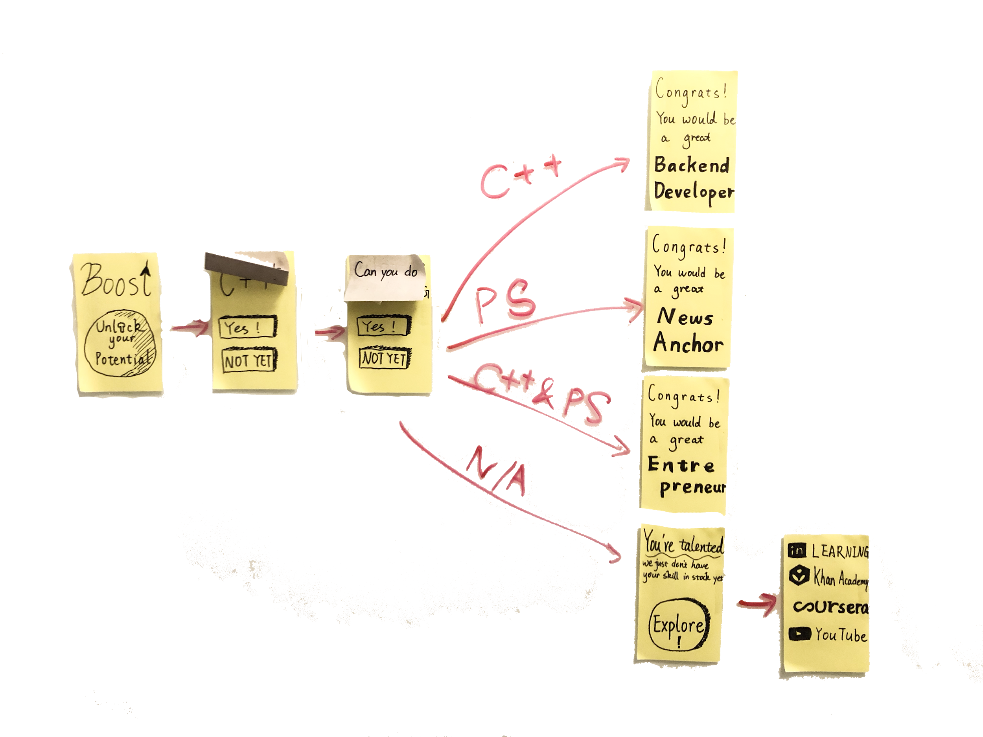
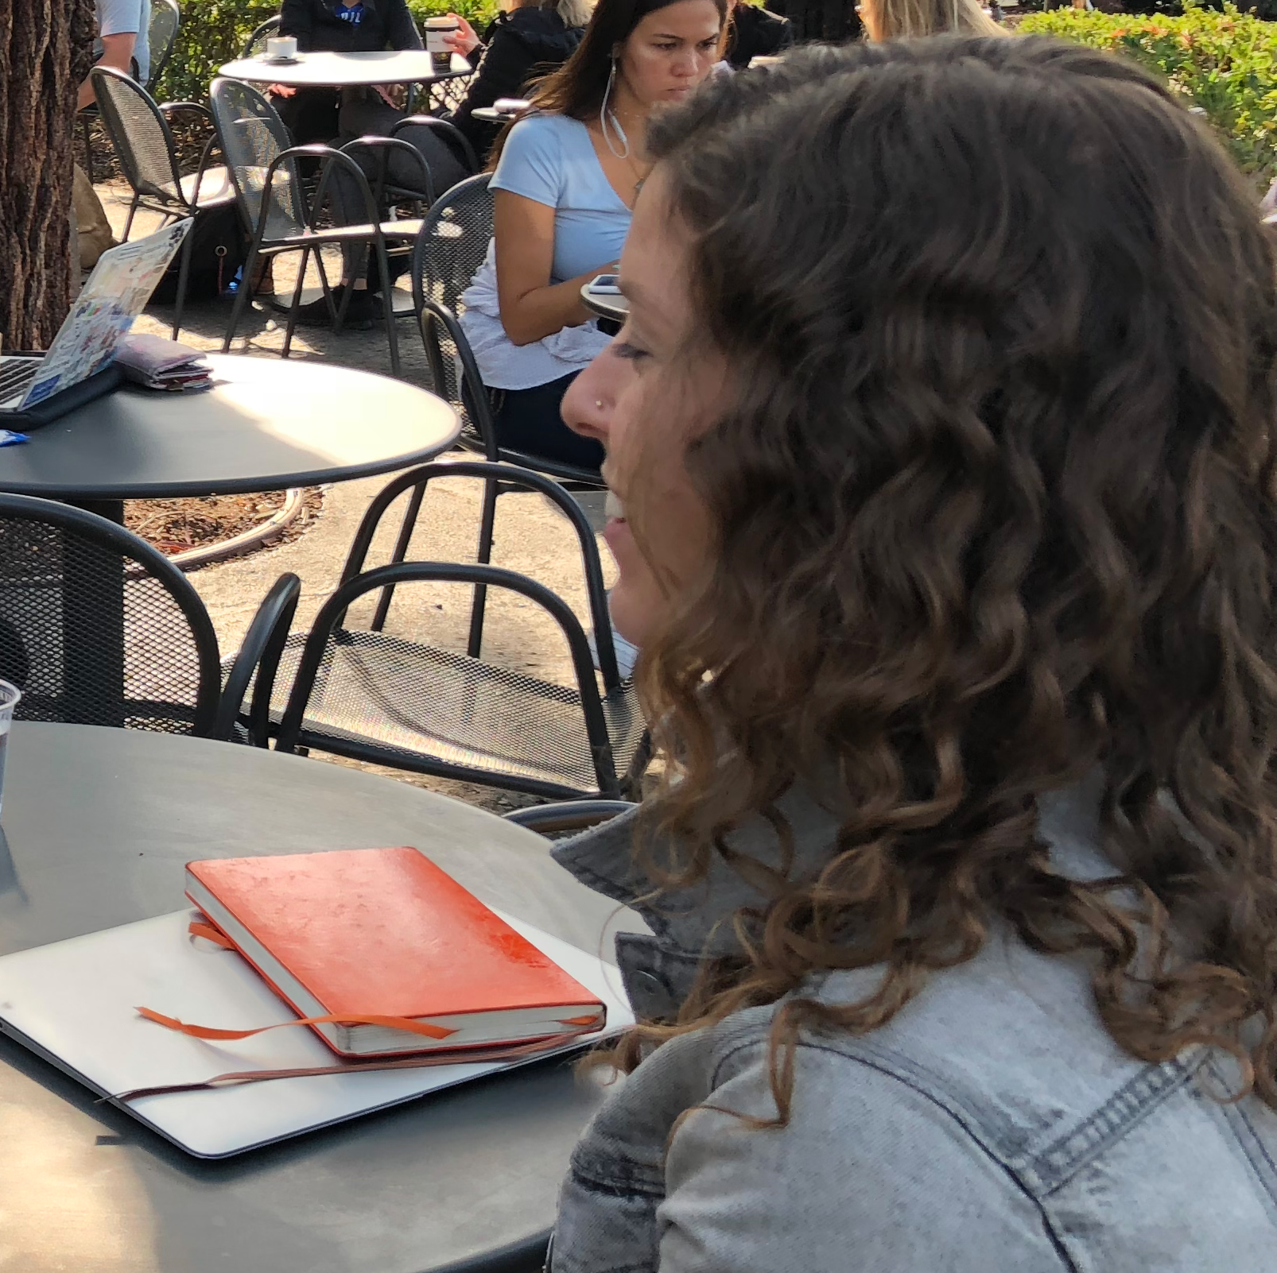
Ally
SSP Associate
@Stanford
Notes:
We use sticky notes of various sizes to simulate a web interface. Imagine the background as the shirt the interviewee (who plays the role of a fashion designer during his/her creative composition) just designed, and the smaller sticky notes as decorators/overlays interviewee have designed so far. The interviewee can see how each decorator would fit with the shirt design, and each sticky note has the capability of rotating in any direction. We interviewers will not interfere with your experimentation.

Slide 26
Assumption
Through recognizing the set of skills one has, he or she would feel more confident about finding jobs that suit the particular skill set.

Slide 27
What worked?
What didn’t?
She picked up the task effortlessly
She didn’t feel like there was a boost of confidence
Intuitive interface
Notes:
Didin’t work: The skills are too low level, there is no sense of validation. She prefers higher level questions of specific problems

Slide 28
Learned?
Assumption Eval
She felt like she would be more confident if she could get more validation from going through the quiz
Pleasant and reacted positively to seeing the final page of job match
She thought low-level, concrete skills are not sufficient for matching people to jobs and self-checking
She suggested more high-level, abstract questions such as: “Have you picked an outfit for others?”

Slide 29
Experience Prototype #3 - FitUp

Slide 30
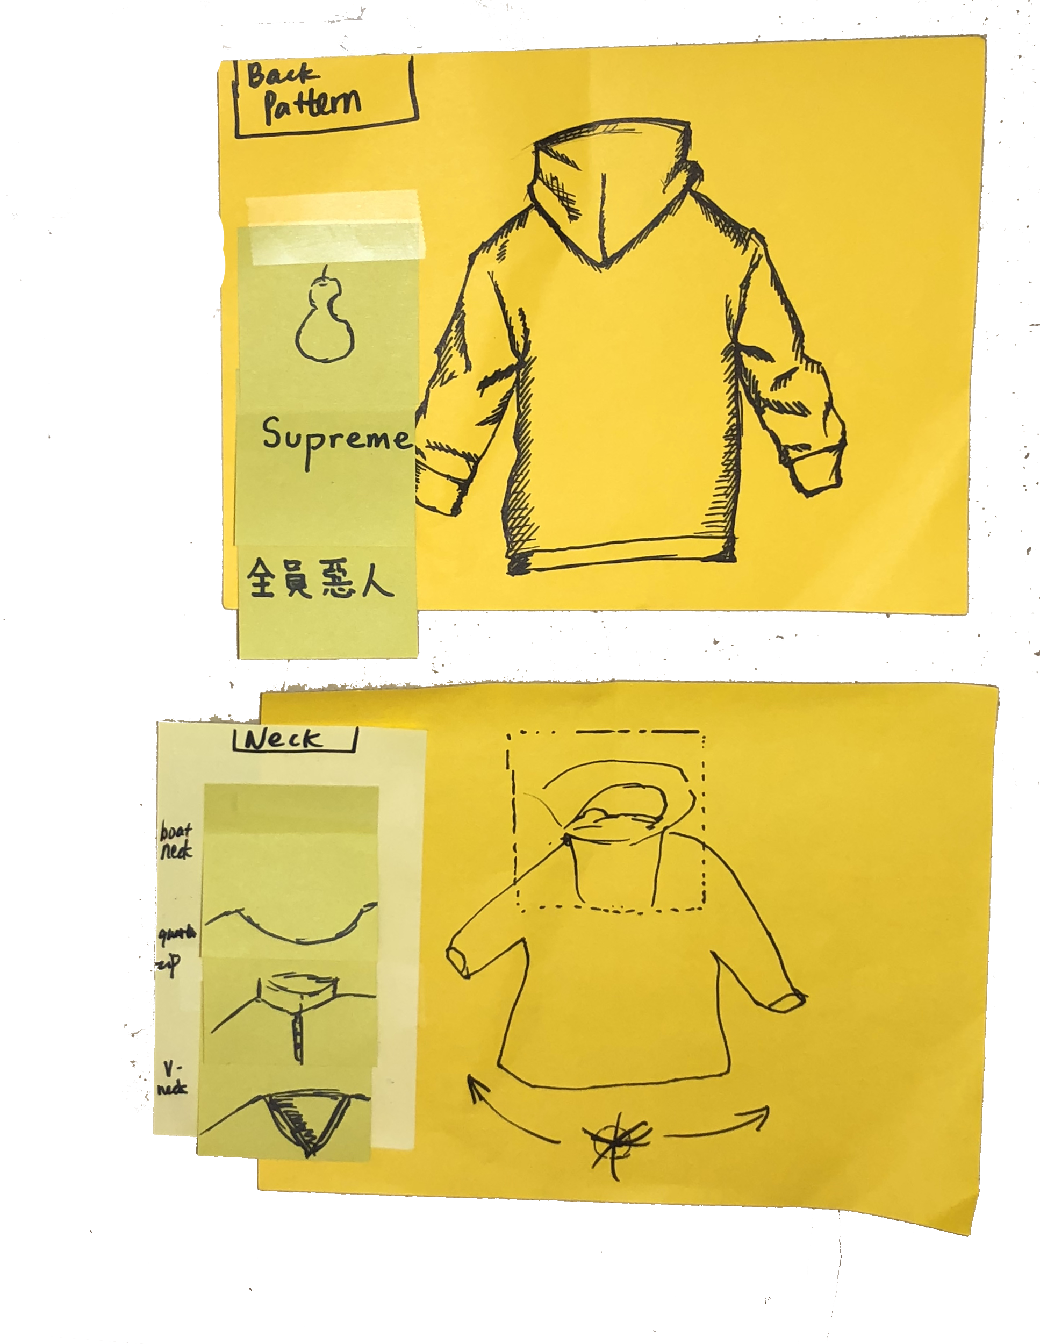
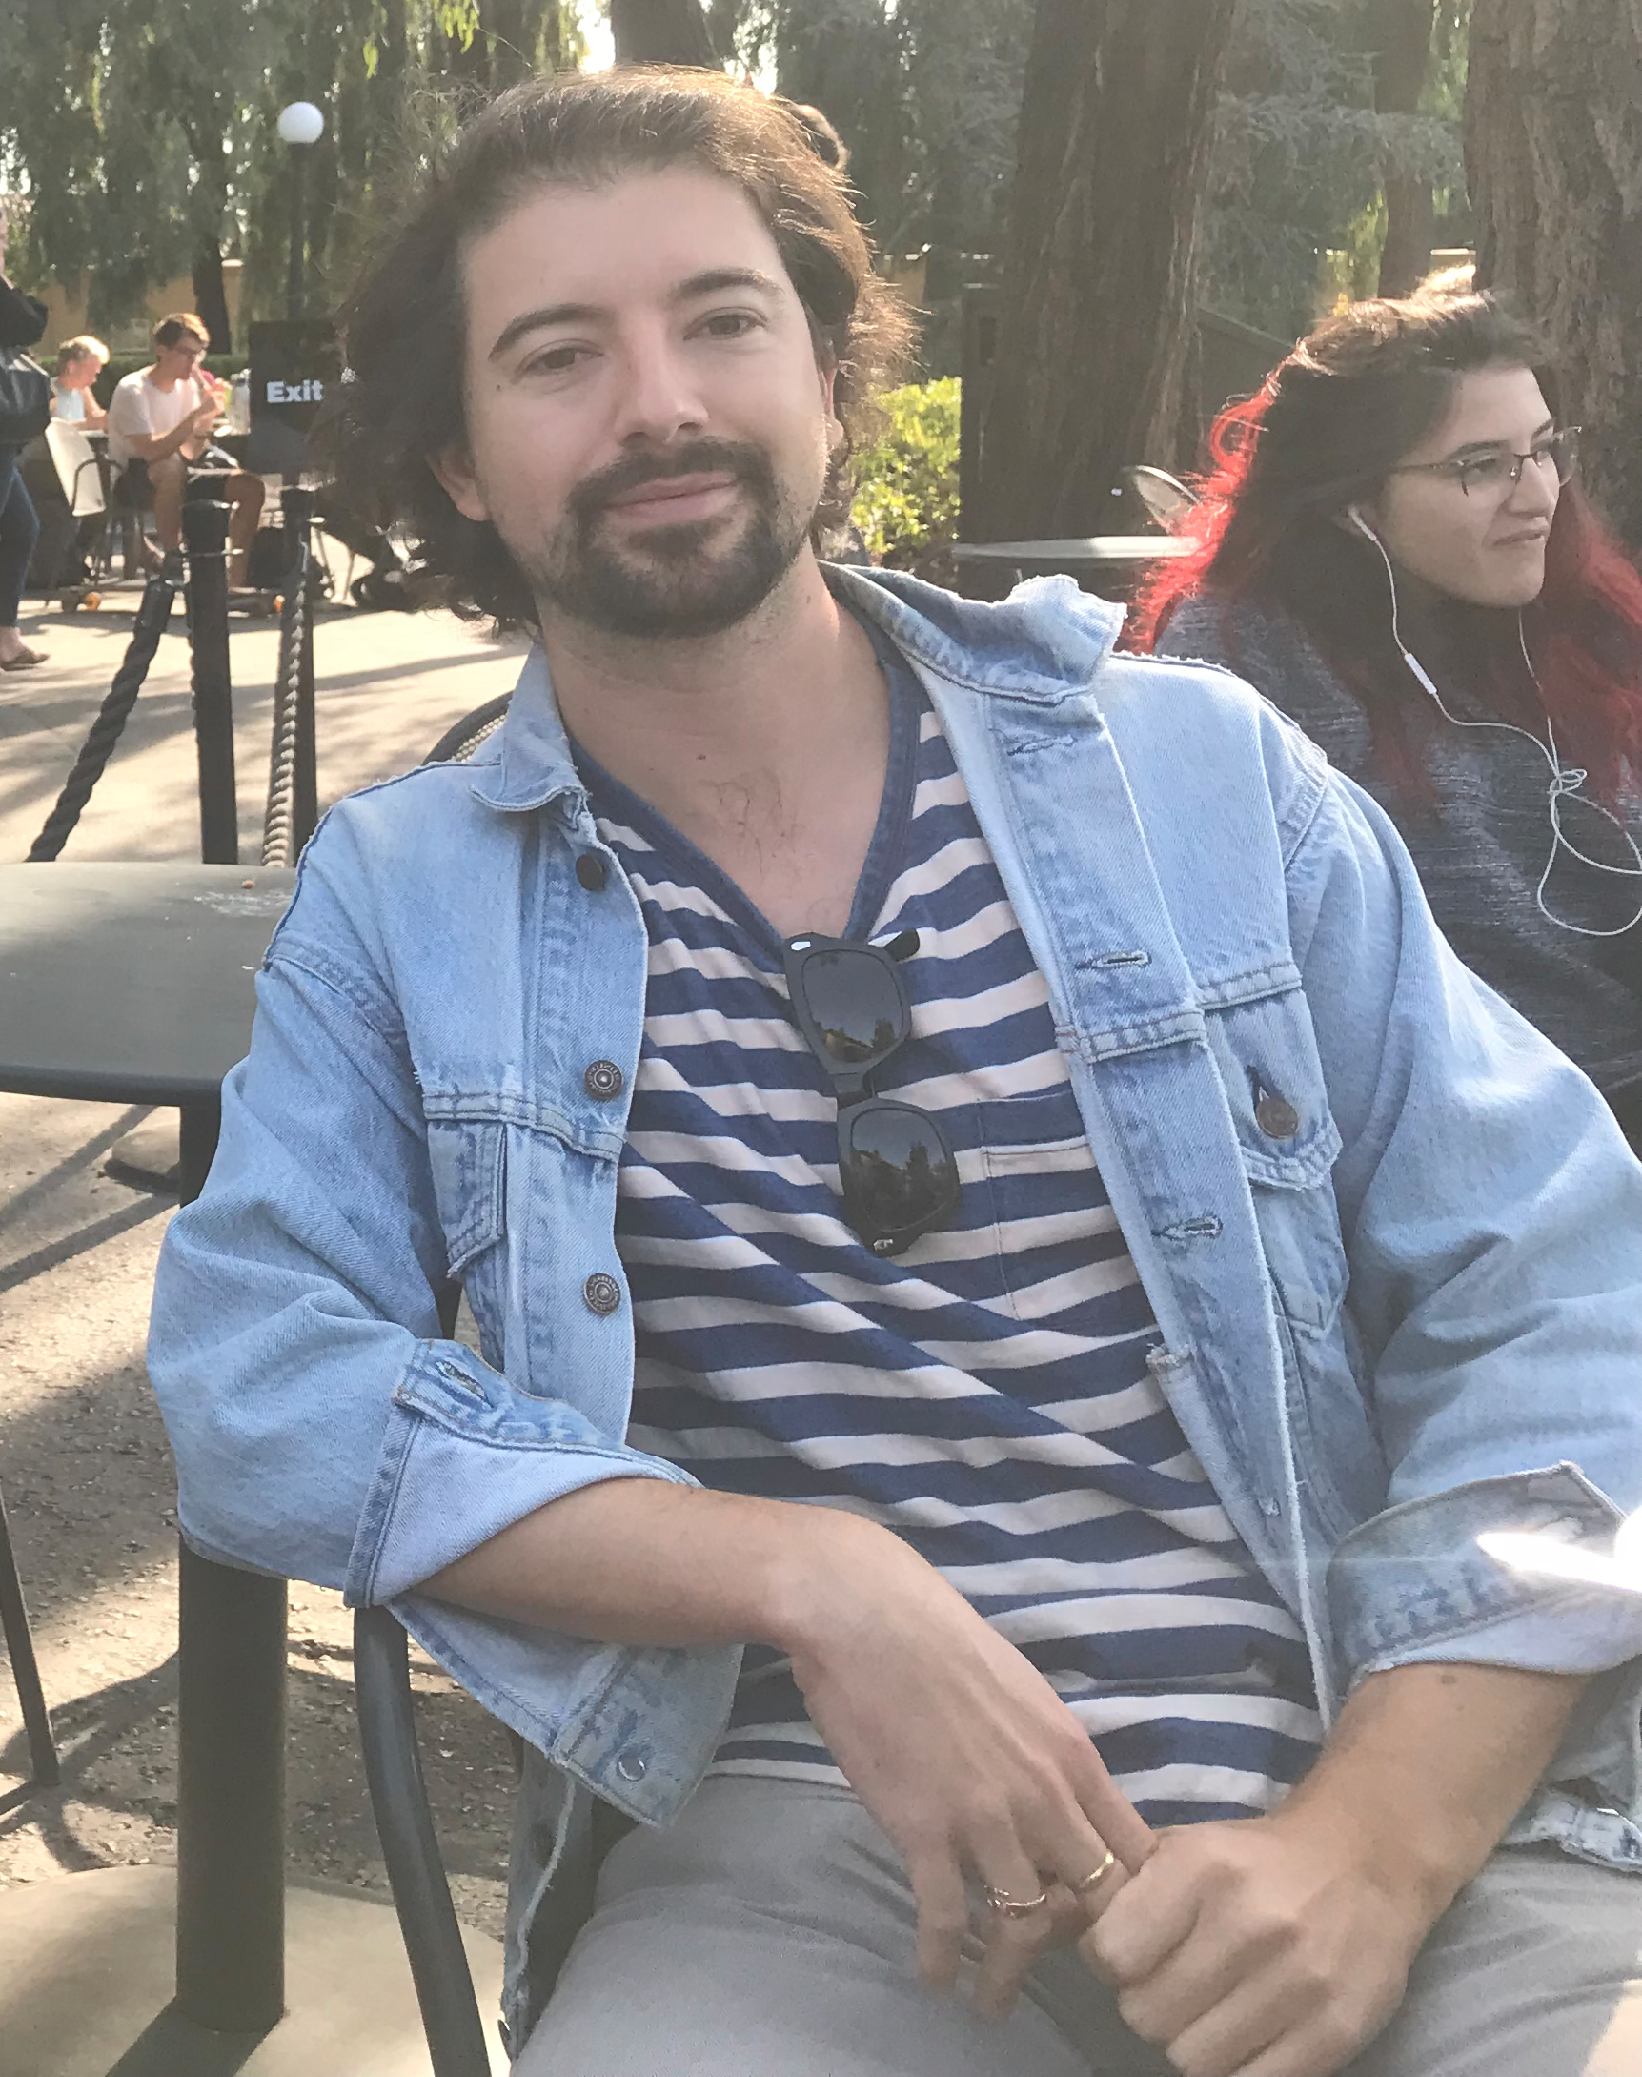
McArdle
28
Visual Storyteller
@SF
Notes:
We use sticky notes of various sizes to simulate a web interface. Imagine the background as the shirt the interviewee (who plays the role of a fashion designer during his/her creative composition) just designed, and the smaller sticky notes as decorators/overlays interviewee have designed so far. The interviewee can see how each decorator would fit with the shirt design, and each sticky note has the capability of rotating in any direction. We interviewers will not interfere with your experimentation.

Slide 31
Assumption
Taking out the hard requirements on technicality would elicit more creative expressions from individuals in the fashion industry and help them better demonstrate ideas and vision.

Slide 32
What worked?
What didn’t?
The interface was instantaneously intuitive
Confused the spin-around icon with a different usage
Right away recognized where the decorator/overlay would go on the garment
Felt a bit underwhelmed by the limited features our prototype offered; difficult to envision what it would feel like to use it in real life
Incorporated his aesthetic tastes into his testing

Slide 33
Learned?
Assumption Eval
“It’s hard to feel super creative in a short time”
He seemed pleased and entertained to play around with the drag-n-drop features of the interface, even though we couldn’t give him the freedom we wished due to material constraints.
It is often better to entrust the participant with the freedom to mess around with our prototype

Slide 34
summary

Slide 35
Summary
What did we learn?
Individual variations
Accuracy of design
Next step?
FitUp! But with more freedom and better 😉
Notes:
Overall, we learned a lot from testing our prototypes on people we thought would fit in our range of target audience. First, we noticed that even though our interviewees roughly fall into our imagined profile of target audience, individuals tend to have different communication patterns, ways to feel validated/motivated and means to fetch information. We noted that prototype Boost and Tech’s It do not account very well for the personal variation, causing our interviewees feelings of misalignment with the obvious purpose of the prototype. In addition, we acknowledged that some paper prototype(i.e. FitUp), because of its extremely low fidelity, does not realize or indicate the extent of freedom we intend to give users in our imagined final product. Therefore, we need to also reflect on how to grant more freedom and incorporate it most effectively into our low-fi prototype.
In the end, we decided to move on with prototype #3, FitUp, as it seemed to be the most intuitive and generated the result most aligned to our initial assumption. Compared to the other two prototypes, it is also broad enough for us to move on accommodating greater individual differences, because as people tend to, let’s say, follow news and trends differently, the process of creation is largely similar and self-explanatory. In the upcoming weeks, we intend to explore more about how people create and how they can feel comfortable/free/undaunted with fashion design using our interface.

Slide 36
THANKS!
Any questions?

Slide 37
*Appendix*

Slide 38
Experience Prototype Pictures
Interview And Testing Pictures
2nd Round Interview Question Guide
2nd Round Interview Consent Forms
2nd Round Interview Notes
2nd Round Interview Empathy Maps
2nd Round Interview Recordings
Full Analysis(Unabridged everything, please read)
Final Written Report

